Slide 1
Reflections Re the 2nd Coming… - Will all recognize what they are seeing… or not?
John 14:29 And now I have told you before it come to pass, that, when it is come to pass, ye might believe.

Slide 2
Reflections Re the 2nd Coming…
Mark 8:11 And the Pharisees came forth, and began to question with him, seeking of him a sign from heaven, tempting him.
Mark 8:12 And he sighed deeply in his spirit, and saith, Why doth this generation seek after a sign? verily I say unto you, There shall no sign be given unto this generation.

Slide 3
Remember the 10 virgins?
Mark 8:13 And he left them, and entering into the ship again departed to the other side.
Mark 8:14 Now the disciples had forgotten to take bread, neither had they in the ship with them more than one loaf.

Slide 4
A Preview of the 2nd Coming?
Matthew 14:25 And in the fourth watch of the night Jesus went unto them, walking on the sea.
Matthew 14:26 And when the disciples saw him walking on the sea, they were troubled, saying, It is a spirit; and they cried out for fear.

Slide 5
Be not afraid!
Matthew 14:27 But straightway Jesus spake unto them, saying, Be of good cheer; it is I; be not afraid.

Slide 6
Yet another Preview of the 2nd Coming?
Mark 6:46 And when he [Jesus] had sent them away, he departed into a mountain to pray.
Mark 6:47 And when even was come, the ship was in the midst of the sea, and he alone on the land.

Slide 7
Are We Recognizing Jesus?
Mark 6:48 And he saw them toiling in rowing; for the wind was contrary unto them: and about the fourth watch of the night he cometh unto them, walking upon the sea, and would have passed by them.
Mark 6:49 But when they saw him walking upon the sea, they supposed it had been a spirit, and cried out:

Slide 8
Be not afraid!
Mark 6:50 For they all saw him, and were troubled. And immediately he talked with them, and saith unto them, Be of good cheer: it is I; be not afraid.

Slide 9
Have you ever heard of “meeting in the air…?”
1 Thessalonians 4:17 Then we which are alive and remain shall be caught up together with them in the clouds, to meet the Lord in the air: and so shall we ever be with the Lord.

Slide 10
Is there a difference between ‘seeing’ and ‘recognizing?’
Revelation 1:7 Behold, he cometh with clouds; and every eye shall see him, and they also which pierced him: and all kindreds of the earth shall wail because of him. Even so, Amen.

Slide 11
Reflections Re the 2nd Coming… - Will all recognize what they are seeing… or not?
John 14:29 And now I have told you before it come to pass, that, when it is come to pass, ye might believe.

Slide 12
‘At hand…” – What does it mean?
Matthew 3:1 In those days came John the Baptist, preaching in the wilderness of Judaea,
Matthew 3:2 And saying, Repent ye: for the kingdom of heaven is at hand.

Slide 13
‘At hand…” – What does it mean?
Mark 1:14 Now after that John was put in prison, Jesus came into Galilee, preaching the gospel of the kingdom of God,
Mark 1:15 And saying, The time is fulfilled, and the kingdom of God is at hand: repent ye, and believe the gospel.

Slide 14
A quote from the Pen of Ellen G. White; from the Pen of Inspiration New Meaning in Familiar Texts
“As soon as the seeker for truth opens the Bible to read the utterances of God with reverence, possessing an earnest desire to know "what saith the Lord," light and grace will be given him, and he will see wondrous things out of God's law. He will not regard the law of Jehovah as a yoke of bondage, but as the gracious commands of One who is all-wise and full of compassion. He will make haste to fulfill His requirements. Great truths which have been neglected and unappreciated for ages, will be revealed by the Spirit of God, and new meaning will flash out of familiar texts. Every page will be illuminated by the Spirit of truth. The Bible is not sealed but unsealed. The most precious truths are revealed; the living oracles are heard by wondering ears, and the consciences of men are aroused into action.” --TSS 30. {CSW 34.3}

Slide 15
Have you seen a diagram similar to this one before?
(From 27 Fundamental Beliefs, Chapter 23)

Slide 16
This diagram is from the Adult Sabbath School Bible Study Guide, 2nd quarter, 2002, Lesson 5:

Slide 17
Same source, 2 years later…

Slide 18
Below the last diagram we find words reminding us of the following familiar teachings:
1. In 457 B.C., Artaxerxes issued the decree; 49 years later (7 prophetic weeks) the city was rebuilt (408 B.C.); Christ was anointed in AD. 27 (the sixty-ninth week) and died in A.D. 31 (the middle of the seventieth week). Stephen died as a martyr in A.D. 34 (the date we use to end the 70-week prophecy), and from that point the gospel went also to the Gentile world.
2. Because the 70 weeks (490 years) are part of the 2,300 years, 457 B.C. becomes the starting point for the 2,300 years, which ended in 1844, the year the cleansing of the heavenly sanctuary was to begin (Dan. 8:14).
3. According to Daniel 7:25, 26, the pre-Advent aspect of the final judgment was to start some time after 1798; we have now the exact year: 1844.

Slide 19
Look at the highlighted text!

Slide 20
Why are we choosing 457 BC? “The only date that works!”

Slide 21
Why are we choosing 457 BC? “The numbers bring us right to the time of Christ!”

Slide 22
“With the starting point given in the decree to restore and rebuild Jerusalem in 457 B.C., we arrive 2,300 years later at 1844. ”

Slide 23
The Word of God is our Ruler
“I recommend to you, dear reader, the Word of God as the rule of your faith and practice. By that Word we are to be judged. God has, in that Word, promised to give visions in the "last days"; not for a new rule of faith, but for the comfort of His people, and to correct those who err from Bible truth. (Acts 10.) {EW 78.1}”

Slide 24
The Holy Scriptures are the Standard
“In His word, God has committed to men the knowledge necessary for salvation. The Holy Scriptures are to be accepted as an authoritative, infallible revelation of His will. They are the standard of character, the revealer of doctrines, and the test of experience. "Every scripture inspired of God is also profitable for teaching, for reproof, for correction, for instruction which is in righteousness; that the man of God may be complete, furnished completely unto every good work." 2 Timothy 3:16, 17, R.V. {GC vii.1}”

Slide 25
What did Sister White say Re What Sister White said…?
“When you make the Bible your food, your meat, and your drink, when you make its principles the elements of your character, you will know better how to receive counsel from God. I exalt the precious Word before you today. Do not repeat what I have said, saying, "Sister White said this," and "Sister White said that." Find out what the Lord God of Israel says, and then do what He commands.--Manuscript 43, 1901. (From an address to church leaders the night before the opening of the General Conference session of 1901.) {3SM 33.1}”

Slide 26
500 year prophecy
“ “Rejoice greatly, O daughter of Zion; shout, O daughter of Jerusalem: behold, thy King cometh unto thee: he is just, and having salvation; lowly, and riding upon an ass, and upon a colt the foal of an ass.” Zech 9:9.
"Five hundred years before the birth of Christ, the prophet Zechariah thus foretold the coming of the King to Israel… It would be needful for His church in all succeeding ages to make His death for the sins of the world a subject of deep thought and study. Every fact connected with it should be verified beyond a doubt.“
(Desire of Ages, p. 569, 571.)

Slide 27
Why is Ellen White emphasizing this? If what we’ve thought we know is true in every detail, then Why is it…?
"It would be needful for His church in all succeeding ages to make His death for the sins of the world a subject of deep thought and study. Every fact connected with it should be verified beyond a doubt.“
(Desire of Ages, p. 569, 571.)

Slide 28
“Five hundred years before the birth of Christ…”
Using default Scriptural reckoning, I find 502 years being complete following the date given in Zechariah 7:1 (2 chapter’s prior to Zech. 9:9) and before the year when the angel Gabriel announced to Mary the birth of her son Yeshua:
“And in the sixth month the angel Gabriel was sent from God unto a city of Galilee, named Nazareth,
“To a virgin espoused to a man whose name was Joseph, of the house of David; and the virgin's name was Mary.”
(Luke 1:26-27)
Cf. http://adamoh.org/TreeOfLife.wan.io/OTCh/Centuries1to7BCE/HaggaiVsZechariahReckoningResolved-Finally!.htm

Slide 29
Per my current reckoning Ellen’s prophecy is off with only 2 years…
Zec 7:1 And it came to pass in the fourth year of king Darius, that the word of the LORD came unto Zechariah in the fourth day of the ninth month, even in Chisleu;
4th year of Darius: Tishri 22, 519 BCE – Tishri 21, 518 BCE
Gabriel’s appearance to Mary: Elul 30±, 16 BCE
Mary’s conception by Joseph: Tishri 10±, 16 BCE
Jesus delivered: Tammuz, 15 BCE
Difference: 518 – 16 = 502 Abib New Moons, not 500…
Per my reckoning: 2 years off target!

Slide 30
If my reckoning is off with 2 years… What about our standard reckoning?
Zec 7:1 And it came to pass in the fourth year of king Darius, that the word of the LORD came unto Zechariah in the fourth day of the ninth month, even in Chisleu;
4th year of Darius = 525 BC (conv.)
Jesus born: ± 4 BC (conv.)
But notice: 525 – 4 = 521 years, not 500!
So standard reckoning is off by 21 years!
Or is Ellen White just giving us round numbers?

Slide 31
There could be some time between Zechariah’s prophecies, couldn’t there?
“And it came to pass in the fourth year of king Darius, that the word of the LORD came unto Zechariah in the fourth day of the ninth month, even in Chisleu;” Zech 7:1
“ “Rejoice greatly, O daughter of Zion; shout, O daughter of Jerusalem: behold, thy King cometh unto thee: he is just, and having salvation; lowly, and riding upon an ass, and upon a colt the foal of an ass.” Zech 9:9

Slide 32
Other Potential Reasons for said 2-year Discrepancy
If Ellen White’s words “the birth of Christ” are meant to indicate:
the “beginning” (= “birth”) of Mary’s passion by the Holy Spirit.
The “beginning” (= “birth”) of Joseph’s and Mary’s relationship
Cf. tinyurl.com/WasMaryPregnant
If Darius Hystaspes’ reign began 2 years later than my present findings…

Slide 33
Ellen G. White wrote:
“I have seen that the 1843 chart was directed by the hand of the Lord, and that it should not be altered; that the figures were as He wanted them; that His hand was over and hid a mistake in some of the figures, so that none could see it, until His hand was removed.” {EW 74.1}

Slide 34
The 1843 Chart

Slide 35
The 1843 Chart

Slide 36
1843 chart 1863 chart

Slide 37
Are we ready to accept the truth as it is being revealed to us?
Is “the hand of the Lord” being removed from the hidden mistake by now? If so, what may we learn about the nature of the mistake? Is it one simple little detail (1843 vs. 1844) or is it a complex pattern of details simply described by the words of the prophet Daniel?:
“He shall speak great words against the most High, and shall wear out the saints of the most High, and think to change times and laws…”

Slide 38
When did Babylon fall?
Jer 25:12 And it shall come to pass, when seventy years are accomplished, that I will punish the king of Babylon, and that nation, saith the LORD, for their iniquity, and the land of the Chaldeans, and will make it perpetual desolations.

Slide 40
Daniel’s “Seventy Seventies” and his “Seven Seventies plus Sixty Seventies plus Two...”
Daniel 9:24-27 is also an exact prophecy of literal days when reckoning from Cyrus’ decree unto the laying of the foundation of the Temple

Slide 41
Daniel 9:24
“…שׁבעים שׁבעים”
What does it mean?

Slide 42
“…שׁבעים שׁבעים”
What translation(s) is/are applicable to the events that did happen?:
“Seventy weeks…” (KJV) and/or
“Seventy seventies…” (TLT.)

Slide 43
Cyrus’ decree predicted:
Isaiah 45:1-8+, 12-14+ (KJV:)
“1 Thus saith the LORD to his anointed, to Cyrus, whose right hand I have holden, to subdue nations before him; and I will loose the loins of kings, to open before him the two leaved gates; and the gates shall not be shut;
“2 I will go before thee, and make the crooked places straight: I will break in pieces the gates of brass, and cut in sunder the bars of iron:
“3 And I will give thee the treasures of darkness, and hidden riches of secret places, that thou mayest know that I, the LORD, which call thee by thy name, am the God of Israel.
“4 For Jacob my servant's sake, and Israel mine elect, I have even called thee by thy name: I have surnamed thee, though thou hast not known me.
“5 I am the LORD, and there is none else, there is no God beside me: I girded thee, though thou hast not known me:
“6 That they may know from the rising of the sun, and from the west, that there is none beside me. I am the LORD, and there is none else.
“7 I form the light, and create darkness: I make peace, and create evil: I the LORD do all these things.
“8 Drop down, ye heavens, from above, and let the skies pour down righteousness: let the earth open, and let them bring forth salvation, and let righteousness spring up together; I the LORD have created it.”
“12 I have made the earth, and created man upon it: I, even my hands, have stretched out the heavens, and all their host have I commanded.
“13 I have raised him up in righteousness, and I will direct all his ways: he shall build my city, and he shall let go my captives, not for price nor reward, saith the LORD of hosts.
“14 Thus saith the LORD, The labour of Egypt, and merchandise of Ethiopia and of the Sabeans, men of stature, shall come over unto thee, and they shall be thine: they shall come after thee; in chains they shall come over, and they shall fall down unto thee, they shall make supplication unto thee, saying, Surely God is in thee; and there is none else, there is no God.

Slide 44
Cyrus’ decree:
2 Chronicles 36:22-23 (KJV:)
“22 Now in the first year of Cyrus king of Persia, that the word of the LORD spoken by the mouth of Jeremiah might be accomplished, the LORD stirred up the spirit of Cyrus king of Persia, that he made a proclamation throughout all his kingdom, and put it also in writing, saying,
“23 Thus saith Cyrus king of Persia, All the kingdoms of the earth hath the LORD God of heaven given me; and he hath charged me to build him an house in Jerusalem, which is in Judah. Who is there among you of all his people? The LORD his God be with him, and let him go up.”

Slide 45
Cyrus’ decree:
Ezra 1:1-4 (KJV:)
“1 Now in the first year of Cyrus king of Persia, that the word of the LORD by the mouth of Jeremiah might be fulfilled, the LORD stirred up the spirit of Cyrus king of Persia, that he made a proclamation throughout all his kingdom, and put it also in writing, saying,
“2 Thus saith Cyrus king of Persia, The LORD God of heaven hath given me all the kingdoms of the earth; and he hath charged me to build him an house at Jerusalem, which is in Judah.
“3 Who is there among you of all his people? his God be with him, and let him go up to Jerusalem, which is in Judah, and build the house of the LORD God of Israel, (he is the God,) which is in Jerusalem.
“4 And whosoever remaineth in any place where he sojourneth, let the men of his place help him with silver, and with gold, and with goods, and with beasts, beside the freewill offering for the house of God that is in Jerusalem.”

Slide 46
Laying the Foundation of the 2nd Temple the 1st Time - Notice especially: “In the second (2nd) month…!”
Ezra 3:6, 8, 10-12 (KJV)
“6 From the first day of the seventh month began they to offer burnt offerings unto the LORD. But the foundation of the temple of the LORD was not yet laid.
“8 Now in the second year of their coming unto the house of God at Jerusalem, in the second month, began Zerubbabel the son of Shealtiel, and Jeshua the son of Jozadak, and the remnant of their brethren the priests and the Levites, and all they that were come out of the captivity unto Jerusalem; and appointed the Levites, from twenty years old and upward, to set forward the work of the house of the LORD.”
“10 And when the builders laid the foundation of the temple of the LORD, they set the priests in their apparel with trumpets, and the Levites the sons of Asaph with cymbals, to praise the LORD, after the ordinance of David king of Israel.
“11 And they sang together by course in praising and giving thanks unto the LORD; because he is good, for his mercy endureth for ever toward Israel. And all the people shouted with a great shout, when they praised the LORD, because the foundation of the house of the LORD was laid.
“12 But many of the priests and Levites and chief of the fathers, who were ancient men, that had seen the first house, when the foundation of this house was laid before their eyes, wept with a loud voice; and many shouted aloud for joy:”
Ezra 5:13-16 (KJV)
“13 But in the first year of Cyrus the king of Babylon the same king Cyrus made a decree to build this house of God.
“14 And the vessels also of gold and silver of the house of God, which Nebuchadnezzar took out of the temple that was in Jerusalem, and brought them into the temple of Babylon, those did Cyrus the king take out of the temple of Babylon, and they were delivered unto one, whose name was Sheshbazzar, whom he had made governor;
“15 And said unto him, Take these vessels, go, carry them into the temple that is in Jerusalem, and let the house of God be builded in his place.
“16 Then came the same Sheshbazzar, and laid the foundation of the house of God which is in Jerusalem: and since that time even until now hath it been in building, and yet it is not finished.”

Slide 47
Laying the Foundation of the 2nd Temple the 2nd Time - Notice especially: “In the ninth (9th) month…!”
Ezra 5:1-2 (KJV)
“1 Then the prophets, Haggai the prophet, and Zechariah the son of Iddo, prophesied unto the Jews that were in Judah and Jerusalem in the name of the God of Israel, even unto them.
“2 Then rose up Zerubbabel the son of Shealtiel, and Jeshua the son of Jozadak, and began to build the house of God which is at Jerusalem: and with them were the prophets of God helping them.”
Haggai 2:18 (KJV)
“18 Consider now from this day and upward, from the four and twentieth day of the ninth month, even from the day that the foundation of the LORD'S temple was laid, consider it.”

Slide 48
Completing the 2nd Temple with the Assistance of their Former Persecutors
Ezra 6:1-8, 15 (KJV)
“1 Then Darius the king made a decree, and search was made in the house of the rolls, where the treasures were laid up in Babylon.
“2 And there was found at Achmetha, in the palace that is in the province of the Medes, a roll, and therein was a record thus written:
“3 In the first year of Cyrus the king the same Cyrus the king made a decree concerning the house of God at Jerusalem, Let the house be builded, the place where they offered sacrifices, and let the foundations thereof be strongly laid; the height thereof threescore cubits, and the breadth thereof threescore cubits;
“4 With three rows of great stones, and a row of new timber: and let the expenses be given out of the king's house:
“5 And also let the golden and silver vessels of the house of God, which Nebuchadnezzar took forth out of the temple which is at Jerusalem, and brought unto Babylon, be restored, and brought again unto the temple which is at Jerusalem, every one to his place, and place them in the house of God.
“6 Now therefore, Tatnai, governor beyond the river, Shetharboznai, and your companions the Apharsachites, which are beyond the river, be ye far from thence:
“7 Let the work of this house of God alone; let the governor of the Jews and the elders of the Jews build this house of God in his place.
“8 Moreover I make a decree what ye shall do to the elders of these Jews for the building of this house of God: that of the king's goods, even of the tribute beyond the river, forthwith expenses be given unto these men, that they be not hindered.
“15 And this house was finished on the third day of the month Adar, which was in the sixth year of the reign of Darius the king.”

Slide 49
Dating Cyrus’ Decree - by what “supplications?”
Dan 9:1-3, 23, 25
“1 In the first year of Darius the son of Ahasuerus, of the seed of the Medes, which was made king over the realm of the Chaldeans;
“2 In the first year of his reign I Daniel understood by books the number of the years, whereof the word of the LORD came to Jeremiah the prophet, that he would accomplish seventy years in the desolations of Jerusalem.
“3 And I set my face unto the Lord God, to seek by prayer and supplications, with fasting, and sackcloth, and ashes:
“23 At the beginning of thy supplications the commandment came forth, and I am come to shew thee; for thou art greatly beloved: therefore understand the matter, and consider the vision.
“25 Know therefore and understand, that from the going forth of the commandment to restore and to build Jerusalem unto the Messiah the Prince shall be seven weeks, and threescore and two weeks: the street shall be built again, and the wall, even in troublous times.”

Slide 50
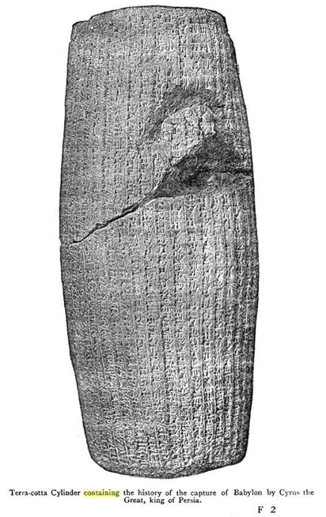
The History of the Capture of Babylon
By Cyrus the Great, king of Persia
Written on a terra-cotta cylinder

Slide 51
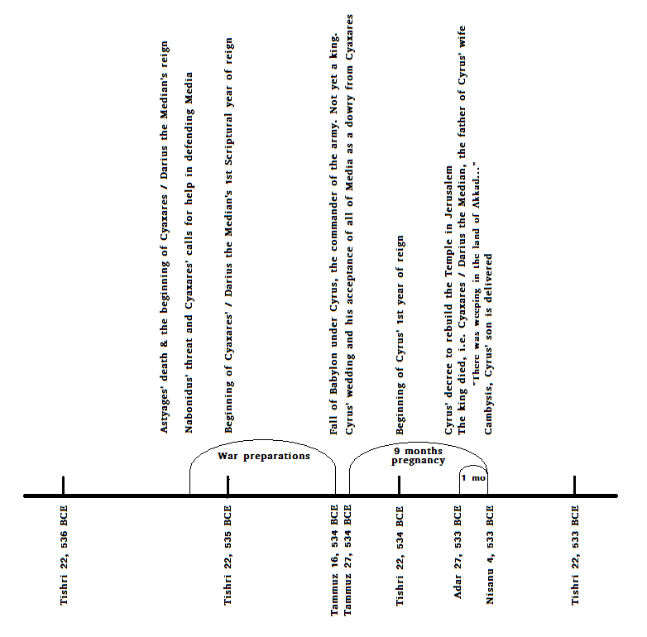
Dated events within one year before and after Babylon’s fall

Slide 52
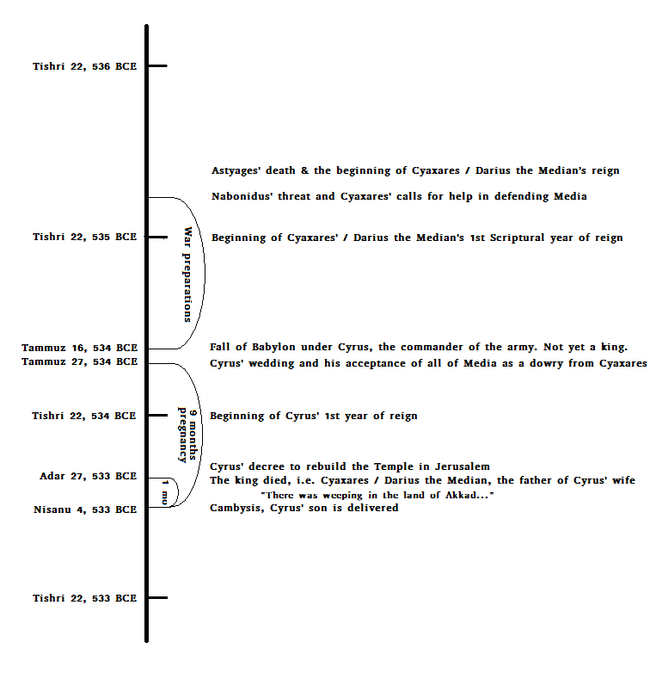
Dated events within one year before and after Babylon’s fall

Slide 53
Dating Cyrus’ Decree The Death of Darius the Mede
“In the month... of the king died. From the twenty-eighth day of the month Adar to the third day of the month Nisan there was weeping in the land Akkad... All the people prostrated their heads."
(SDA Bible Student's Sourcebook [i.e. SDA Bible Commentary,] Vol. 9, p. 305; Source: Raymond Philip Dougherty, Nabonidus and Belshazzar, (Yale Oriental Series Researches, Vol. 15. New Haven, Conn.: Yale University Press, 1929), pp. 168-173.)

Slide 54
Here’s another translation of the same ancient terra cotta cylinder text previously quoted out of the SDA Bible commentary:
“In the month of Marchesvan (October) the dark, the 11th day, Gobryas .... and the king [Not Nabonidus, but Cyaxares/Darius the Mede /gs edit] died. From the 27th of the month Adar (February) to the 3rd day of the month Nisan (March) there was weeping in Akkad. All the people were free from their chief. On the 4th day Cambyses, the son of Cyrus, in the Temple of the Sceptre of the-World, established a festival.”
(Ernest Alfred Wallis Budge, Babylonian Life and History, p. 82; also at this link.)

Slide 55
When did Darius, king of Media begin his reign?
[1.5.2] In the course of time Astyages died in Media, and Cyaxares, the son of Astyages and brother of Cyrus's mother, succeeded to the Median throne. At that time the king of Assyria had subjugated all Syria, a very large nation, and had made the king of Arabia his vassal…
[1.5.3] Accordingly, he sent around to all those under his sway and to Croesus, the king of Lydia, to the king of Cappadocia; to both Phrygias, to Paphlagonia, India, Caria, and Cilicia; and to a certain extent also he misrepresented the Medes and Persians, for he said that they were great, powerful nations, that they had intermarried with each other, and were united in common interests, and that unless some one attacked them first and broke their power, they would be likely to make war upon each one of the nations singly and subjugate them.
[1.5.4] Now when Cyaxares heard of the plot and of the warlike preparations of the nations allied against him, without delay he made what counter preparations he could himself and also sent to Persia both to the general assembly and to his brother-in-law, Cambyses, who was king of Persia. And he sent word to Cyrus, too, asking him to try to come as commander of the men, in case the Persian state should send any troops.
(Xenophon (ca 430-355 BCE,) The Life of Cyrus The Great)

Slide 56
When did Cyrus begin his reign?
[7.5.20] "My friends," said he, "the river has made way for us and given us an entrance into the city. Let us, therefore, enter in with dauntless hearts, fearing nothing and remembering that those against whom we are now to march are the same men that we have repeatedly defeated, and that, too, when they were all drawn up in battle line with their allies at their side, and when they were all wide awake and sober and fully armed;
[7.5.33] And when day dawned and those in possession of the citadels discovered that the city was taken and the king slain, they surrendered the citadels, too.
[8.5.19] As the princess placed the crown on Cyrus's head, Cyaxares said, "And the maiden herself, my own daughter, I offer you as well, Cyrus, to be your wife. Your father married my father's daughter, whose son you are. This is she whom you used often to pet when you came to visit us when you were a boy. And whenever anybody asked her whom she was going to marry, she would say `Cyrus.' And with her I offer you all Media as a dowry, for I have no legitimate male issue."
[8.5.28] When, on his way back, he came to Media, Cyrus wedded the daughter of Cyaxares, for he had obtained the consent of his father and mother.

Slide 57
When did Babylon fall?
In the Month Tammuz (June) Cyrus made battle in Rutum against . . . . of the river Nizallat. The men of Akkad made a revolt. The soldiers took Sippara on the 14th day without fighting, and Nabonidus fled away. On the 16th day Gobryas, the governor of Gutium, and the army of Cyrus came to Babylon without any opposition. Afterwards having bound Nabonidus, he took him to Babylon. At the end of the month Tammuz the rebels of Gutium closed the gates of E-sagili;

Slide 58
When did Babylon fall?
Jer 25:12 “And it shall come to pass, when seventy years are accomplished, that I will punish the king of Babylon, and that nation, saith the LORD, for their iniquity, and the land of the Chaldeans, and will make it perpetual desolations.”
Nebuchadnezzar’s 1st Scriptural year of reign began Tishri 22, 605 BCE.
The first Scriptural year of the Babylonian captivity is the same as Nebuchadnezzar’s 1st Scriptural year of reign.
The 70th Scriptural year of the Babylonian captivity began Tishri 22, 536 BCE and ended Tishri 21, 535 BCE.
Babylon fell on Tammuz 16 after 70 completed years of Babylonian captivity, i.e. Tammuz 16, 534 BCE.

Slide 59
When did Cyrus’ reign begin?
Cyrus’ oldest son was delivered by Nisan 4, 533 BCE.
Av 5, 534 BCE is the latest day Cyrus’ son could have been conceived, if his son was a full-term baby delivered before Nisan 4, 533 BCE.
Thus, Cyrus wedding was no later than Av 5, 534 BCE; 19 days after the fall of Babylon.
It follows that Cyrus consummated his marriage and received Media as a dowry no later than Av 5, 534 BCE.
The 4,900 literal day prophecy of Daniel begin Tammuz 27, 534 BCE, just one week before that!

Slide 60
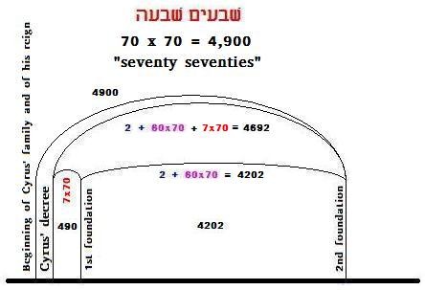

Slide 61
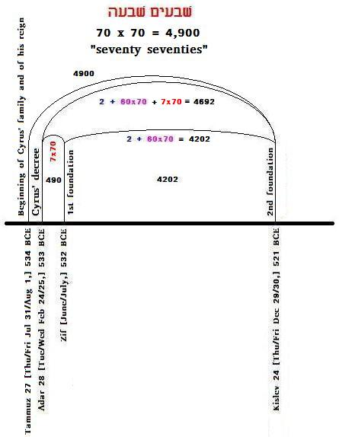
Exactly dated

Slide 62
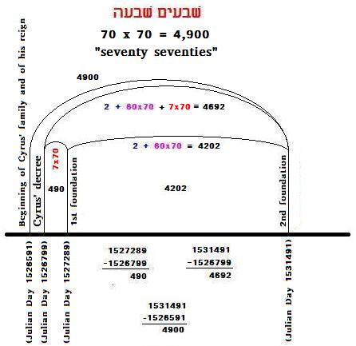

Slide 63
When did Cyrus’ 1st Scriptural year of reign begin?
Cyrus’ accession year began at his wedding on or before Av 5, 534 BCE.
Thus, Cyrus’ 1st Scriptural year of reign began on Tishri 22, 534 BCE.

Slide 64
When did Darius’ 1st year begin and end?
Dan 9:1 “In the first year of Darius the son of Ahasuerus, of the seed of the Medes, which was made king over the realm of the Chaldeans;”
Thus, Darius’ 1st Scriptural year of reign began Tishri 22, 535 BCE.
That year ended Tishri 21, 534 BCE.

Slide 65
When did Daniel 9 happen?
Dan 9:1 “In the first year of Darius the son of Ahasuerus, of the seed of the Medes, which was made king over the realm of the Chaldeans;”
Dan 9:3 “And I set my face unto the Lord God, to seek by prayer and supplications, with fasting, and sackcloth, and ashes:”
After Babylon’s fall, Tammuz 16, 534 BCE.
Before the end of Darius’ 1st year, Tishri 21, 534 BCE.
Before the beginning of Cyrus’ 1st year, Tishri 22, 534 BCE.
Thus, probably on Day of At-One-Meant, the “Day of Fasting:” Tishri 10, 534 BCE.

Slide 66
When was Cyrus’ decree issued?
Dan 9:23 At the beginning of thy supplications the commandment came forth, and I am come to shew thee; for thou art greatly beloved: therefore understand the matter, and consider the vision.
Dan 9:25 Know therefore and understand, that from the going forth of the commandment to restore and to build Jerusalem…
Was Cyrus’ decree issued on Tishri 10, 534 BCE?
Yes, the “commandment came forth,” but…
No, this was still Cyrus’ accession year. The decree was not formally issued, “from the going forth,” as yet. There seems to be a difference!
Its like making a decision in the evening at home, then acting on it in the morning at work…

Slide 67
What is the difference?
H3318, יצא, yâtsâ‘, yaw-tsaw‘ ; A primitive root; to go (causatively bring) out, in a great variety of applications, literally and figuratively, direct and proximate
H4161, מצא מוצא, môtsâ' môtsâ‘ ; mo-tsaw', mo-tsaw‘ ; From H3318; a going forth, that is, (the act) an egress, or (the place) an exit; hence a source or product; specifically dawn, the rising of the sun (the East), exportation, utterance, a gate, a fountain, a mine, a meadow (as producing grass)

Slide 68
Further evidence for this distinction 1
“The commandment came forth” (Daniel 9:23) vs. “from the going forth…” (v. 25) and “a proclamation… also in writing:”
2Ch 36:22 Now in the first year of Cyrus king of Persia, that the word of the LORD spoken by the mouth of Jeremiah might be accomplished, the LORD stirred up the spirit of Cyrus king of Persia, that he made a proclamation throughout all his kingdom, and put it also in writing, saying,
Ezr 1:1 Now in the first year of Cyrus king of Persia, that the word of the LORD by the mouth of Jeremiah might be fulfilled, the LORD stirred up the spirit of Cyrus king of Persia, that he made a proclamation throughout all his kingdom, and put it also in writing, saying…

Slide 69
Further evidence for this distinction 2
If Cyrus’ decree had been published by Tishri 534, then the people would likely have gone to Jerusalem for the Feast of Unleavened Bread. Then Ezra 3:1 would have read “the first month” not “the seventh month:”
Ezr 3:1 And when the seventh month was come, and the children of Israel were in the cities, the people gathered themselves together as one man to Jerusalem.
Ezr 3:6 From the first day of the seventh month began they to offer burnt offerings unto the LORD. But the foundation of the temple of the LORD was not yet laid.
Ezr 3:8 Now in the second year of their coming unto the house of God at Jerusalem, in the second month, began Zerubbabel the son of Shealtiel, and Jeshua the son of Jozadak, and the remnant of their brethren the priests and the Levites, and all they that were come out of the captivity unto Jerusalem; and appointed the Levites, from twenty years old and upward, to set forward the work of the house of the LORD.
Ezr 3:10 And when the builders laid the foundation of the temple of the LORD, they set the priests in their apparel with trumpets, and the Levites the sons of Asaph with cymbals, to praise the LORD, after the ordinance of David king of Israel.

Slide 70
Do you begin to see the difference?
Day of At-One-Meant is like the evening of the year, Tishri 10. The very end of the year is Tishri 21. The end of the hot season, like the end of the day…
Aviv 1 is like the dawn of the year, sunrise...
Adar 28 is only two days before Aviv 1…
The day when Darius, the king died…

Slide 71
When did Darius the Mede die?
“In the month... of the king died. From the twenty-eighth day of the month Adar to the third day of the month Nisan there was weeping in the land Akkad... All the people prostrated their heads."
(SDA Bible Student's Sourcebook [i.e. SDA Bible Commentary,] Vol. 9, p. 305; Source: Raymond Philip Dougherty, Nabonidus and Belshazzar, (Yale Oriental Series Researches, Vol. 15. New Haven, Conn.: Yale University Press, 1929), pp. 168-173.)

Slide 72
Where was Cyrus on Tishri 10?
Remember Cyrus’ wedding in Media on or before Av 5, 534 BCE…
That’s were Darius, the bride’s father, was too.
At home…
“At the end of the month Tammuz the rebels of Gutium closed the gates of E-sagili... In the month Marchesvan [October, the 8th month], the 3rd day, Cyrus came to Babylon, the roads were dark before him. He made peace to the city and promised peace to all Babylon.”
(Terra-cotta: Cyrus the Great, The History of the Capture of Babylon)

Slide 73
Summing up the events - 1
Dan 9:1 “In the first year of Darius the son of Ahasuerus, of the seed of the Medes, which was made king over the realm of the Chaldeans;”
Astyages died leaving his kingdom, Media, to Cyaxares / Darius the Mede <12 months before the fall of Babylon.
Darius’ 1st year of reign began Tishri 22, 535 BCE.
Babylon fell Tammuz 16, 534 BCE.

Slide 74
Summing up the events - 2
Cyrus’ accession year began at his wedding no later than Av 5, 534 BCE when he received Media as a dowry from Darius, king of Media.
More importantly, it began when Cyrus’ father and mother consented for him to accept the offer of Darius, king of Media.
Daniel’s 4,900 literal day prophecy began with Tammuz 27, 534 BCE.

Slide 75
Summing up the events - 3
“The commandment…” for Cyrus’ decree came Tishri 10, 534 BCE.
Cyrus’ 1st year of reign began Tishri 22, 534 BCE.
Darius the Mede died before Adar 28, 533 BCE.
Cyrus’ decree was “proclaimed… and put also in writing” before Adar 28, 533 BCE.

Slide 76
Was Cyrus’ decree issued Aviv 27, 533 BCE?
Was Aviv 28, 533 BCE the 1st effective day of Cyrus’ decree?
Does the Holy Scriptures confirm this date?
If so, how?

Slide 77
The Kings and their Reigns
Nabonidus and
his son Belshazzar (co-ruler)
Darius the Mede
Cyrus (became king upon receiving Media as dowry)
Cambyses
False Smerdis
Darius Hystaspes
552 BCE – Tammuz 16, 534 BCE (June 21, summer solstice day)
536/535 BCE - Adar 27±, 533 BCE
Tammuz 27, 534 BCE – 525(/524) BCE
530 – Av 6, 523 BCE
Av 6, 523 – Nisanu 10, 522
Nisanu 10, 522 – 486/485

Slide 78
Dating the events of the 4900 days:
1st official day of Cyrus’ decree:
Adar 28 [Tue/Wed Feb 24/25,] 533 BCE
Laying the Foundation of the Temple in Jerusalem 1st Time:
Zif [June/July,] 532 BCE
Laying the Foundation of the Temple in Jerusalem 2nd Time:
Kislev 24 [Thu/Fri Dec 29/30,] 521 BCE
What is the key to the 4,900 day event?:
“I am the way, the truth, and the life: no man cometh unto the Father, but by me.” John 14:6
The answer is found in the beginning: The Creator, the Founder and proprietor of every family. Specifically, the decision to covenant: The consent of Cyrus’ father and mother for Cyrus to accept Cyaxares’ offer granting him his daughter and all of Media. Date of acceptance: Tammuz 27, 534 BCE…
. . .
[The Temple finished on:]
Adar 3 [Sabbath Jan 22/23 or Sabbath Feb 19/20,] 516 BCE

Slide 82
What is the Connection…?
“Unto the laying the foundation of the Temple” vs. “unto the Messiah the Prince” (Daniel 9:25)
Is there only one application of those last words, e.g. Jesus Christ or Yeshua Messiah, or may the Hebrew words thus translated be applied in another sense also?
To put it slightly differently: Is it true that the words of the bible can only be understood in one way, and if so, who is given the authority to make such interpretations? Is it true that only the Pope has been given such authority?

Slide 83
What does “משׁיח נגיד” mean?
First, notice that there is no definite article corresponding to the KJV translation “the… the…” in “the Messiah the Prince.”
A more correct translation then is “a messiah prince” or “a princely messiah.”
May we learn something more from Strong’s Concordance of the Bible…?
What’s the meaning of those Hebrew words: “משׁיח נגיד” ?

Slide 84
Strong’s re “נגד” or KJV’s transl. “prince”
H5057
נגד נגיד
nâgîyd nâgid
naw-gheed', naw-gheed'
From H5046; a commander (as occupying the front), civil, military or religious; generally (abstract plural), honorable themes: KJV - captain, chief, excellent thing, (chief) governor, leader, noble, prince, (chief) ruler.
H5046
נגד
nâgad
naw-gad'
A primitive root; properly to front, that is, stand boldly out opposite; by implication (causatively), to manifest; figuratively to announce (always by word of mouth to one present)

Slide 85
Strong’s re “משׁיח” or KJV’s transl. “Messiah”
H4899
משׁיח
mâshîyach
maw-shee'-akh
From H4886; anointed; usually a consecrated person (as a king, priest, or saint); specifically the Messiah: - anointed, Messiah.
H4886
משׁח
mâshach
maw-shakh'
A primitive root; to rub with oil, that is, to anoint; by implication to consecrate; also to paint: - anoint, paint.

Slide 86
What does “משׁיח נגיד” mean?
May those words apply to a prophet of the Lord when he is announcing a “word of the Lord?”
May those words apply to Haggai or Zechariah? As in “a front man standing out boldly while announcing the clear message he is given from the Lord of Truth?”
May those words be applied to the originator of a message or to the one transmitting a message to you or I?
Could “משׁיח נגיד” apply to something or some one re Haggai 2:17-18?:
“17 …saith the LORD
“18 Consider now from this day and upward, from the four and twentieth day of the ninth month, even from the day that the foundation of the LORD'S temple was laid, consider it.”

Slide 87
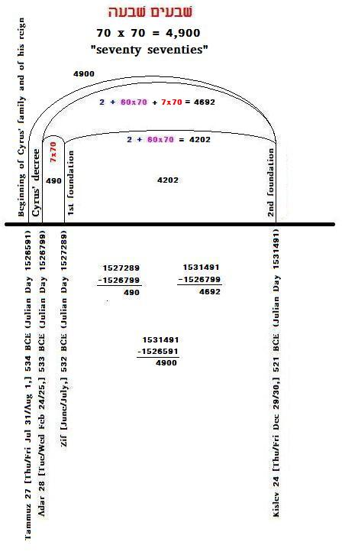
Is this a valid application of Daniel 9:25-26?

Slide 88
Daniel 9:25-26
שׁבעים שׁבעה
ושׁבעים שׁשׁים
ושׁנים
What does it mean?
70*7 + 70*60 + 2 = 4692 days?
Could it apply to something else too?

Slide 89
Daniel 9:24
“…שׁבעים שׁבעים”
What does it mean?
70 * 70?!
Could it apply to something else too?

Slide 90
What about Daniel’s “one week” and “in the midst of the week?”
Dan 9:27 (KJV)
“And he shall confirm the covenant with many for one week: and in the midst of the week he shall cause the sacrifice and the oblation to cease, and for the overspreading of abominations he shall make it desolate, even until the consummation, and that determined shall be poured upon the desolate.”

Slide 91
Dating Cyrus’ Decree The Death of Darius the Mede
“In the month... of the king died. From the twenty-eighth day of the month Adar to the third day of the month Nisan there was weeping in the land Akkad... All the people prostrated their heads."
(SDA Bible Student's Sourcebook [i.e. SDA Bible Commentary,] Vol. 9, p. 305; Source: Raymond Philip Dougherty, Nabonidus and Belshazzar, (Yale Oriental Series Researches, Vol. 15. New Haven, Conn.: Yale University Press, 1929), pp. 168-173.)

Slide 92
The Beginning of a new Era of an Old Covenant Defined - I
Adar 28, 533 BCE = Beginning at sunset Tue Feb 24, 533 BCE
Given that Cyrus’ son was delivered by Nisan 4, said Adar 28, was Adar I 28, followed by Adar II, then Nisan…
Do you notice the relationship between the end of Adar II and the date given by Zechariah?! – It is like a second dawn, isn’t it?! It’s as if there was a solar eclipse at the time of, and interfering with, dawn… Like “the death of a king…” [Cf. my study re the death of King Saul…]
The Hebrew words “שׁבוע אחד” translated “one week” may simply point to the 1st week, literally “week one,” of this prophecy and the fact that the reckoning is to begin “in the midst of the week,” i.e. on the Fourth Day of the week beginning at sunset Tue Feb 24, 533 BCE!

Slide 93
The Beginning of a new Era of an Old Covenant Defined - II
In the Scriptures, as in all real life events, beginnings are always of utmost importance. Thus it is most important to define the beginning of this prophecy precisely.
In this case the Scriptures are defining the exact date of an ancient Covenant that is being re-confirmed. It is the same Covenant as was offered to each and all men and specifically to Adam, Seth, Enoch, Noah, Shem, Abraham, Isaac, Jacob, Moses…
The point in time here indicated is the decree of Cyrus’ for the release of the captives who had been in Babylon for a full 70 years at this point in time. Cf. Daniel 9:2. Thus the words “he shall cause the sacrifice and the oblation to cease, and for the overspreading of abominations he shall make it desolate, even until the consummation” Daniel 9:27.

Slide 94
The Beginning of a new Era of an Old Covenant Defined - III
One 490± year cycle had come to an end that had begun with the People of Israel asking for themselves a king – like the people around them. A new 490 year cycle was beginning. Would the new generation accept the good parts of the old covenant or would they not care, repeat the mistakes of prior generations, and lose out on many or even most of the potential blessings in store for them by means of this Covenant?

Slide 95
The Beginning of a new Era of an Old Covenant Defined – IV
Would any and each among them accept the direct relationship offered them by their Creator or would they be too afraid and choose instead to elect or vote for themselves another man-made State or king – as had the people done throughout the last 490 years before them? Cf. Deuteronomy 5:2-5 and 1 Samuel 8! Would they truly come out of the State represented by Nebuchadnezzar’s Statue or would they prefer to keep on bending their knees and subjugating themselves for all that that Stat(u)e represents?!

Slide 96
The Beginning of a new Era of an Old Covenant Defined – V
Would they, any one among them, be willing to accept the total freedom offered them – first by means of an understanding of God’s own principles re covenants – second, specifically by Cyrus, and then again, a third time, by Darius?
Or, would they settle for another man-made Savior at the end of the next 490 year era? I.e. the Roman Empire, beginning with Herod the Great’s conquest of Jerusalem?
How about us here and now, (U) and I? Cf. Deut. 5:2-5!!!

Slide 97
Darius’ decree to set God’s People free for ever
Ezra 6:7-12 (KJV)
“7 Let the work of this house of God alone; let the governor of the Jews and the elders of the Jews build this house of God in his place.
“8 Moreover I make a decree what ye shall do to the elders of these Jews for the building of this house of God: that of the king's goods, even of the tribute beyond the river, forthwith expenses be given unto these men, that they be not hindered.
“9 And that which they have need of, both young bullocks, and rams, and lambs, for the burnt offerings of the God of heaven, wheat, salt, wine, and oil, according to the appointment of the priests which are at Jerusalem, let it be given them day by day without fail:
“10 That they may offer sacrifices of sweet savours unto the God of heaven, and pray for the life of the king, and of his sons.
“11 Also I have made a decree, that whosoever shall alter this word, let timber be pulled down from his house, and being set up, let him be hanged thereon; and let his house be made a dunghill for this.
“12 And the God that hath caused his name to dwell there destroy all kings and people, that shall put to their hand to alter and to destroy this house of God which is at Jerusalem. I Darius have made a decree; let it be done with speed.

Slide 98
A Personal Covenant Between God and Each Man (NOT hue-man!)
Deuteronomy 5:2-5 (KJV)
“2 The LORD our God made a covenant with us in Horeb.
“3 The LORD made not this covenant with our fathers, but with us, even us, who are all of us here alive this day.
“4 The LORD talked with you face to face in the mount out of the midst of the fire,
“5 (I stood between the LORD and you at that time, to shew you the word of the LORD: for ye were afraid by reason of the fire, and went not up into the mount;)

Slide 99
God Does Not Interfere in Obligations We are Willingly Accepting!
1 Samuel 8:18 (KJV)
“And ye shall cry out in that day because of your king which ye shall have chosen you; and the LORD will not hear you in that day.”

Slide 100
God is Calling Me and U Now!
Rev 18:4 (KJV)
“And I heard another voice from heaven, saying, Come out of her, my people, that ye be not partakers of her sins, and that ye receive not of her plagues.”

Slide 101
The Kingdom of God… is what U make of it!
Says John the Baptist:
“Repent ye: for the kingdom of heaven is at hand.” Matthew 3:2 (KJV.)
Says Jesus, the Messiah:
“The time is fulfilled, and the kingdom of God is at hand: repent ye, and believe the gospel.” Mar 1:15 (KJV.)

Slide 102
Daniel’s 490 Year Prophecies
Considering the importance placed by the Scriptures upon beginnings it is clear that one such beginning is being defined by the decree issued in Cyrus’ 1st year of reign.
What 490 year eras may we identify in the Scriptures, based upon this point in time?

Slide 103
534 BCE ± 490 Years
Cyrus’ decree: Adar 28, 534 BCE. (Babylon did not fall in 539 BCE as commonly taught! This error is based upon reading too much into Ptolemy’s Canon.)
534 BCE + 490± years = 1024± BCE.
534 BCE – 490 years = 44 BCE.
The Egyptian calendar begins with the month Thoth. Egyptian calendar reckoning always precedes the Hebrew and Babylonian reckoning because no accession year is reckoned using the Egyptian calendar. Indeed, the Elephantine papyri shows clearly that at times the 2nd Egyptian year of reign began even while the Babylonian and Hebrew calendars were in their respective accession year of reign. (Cf. the Elephantine papyri dated during Artaxerxes I. See more at: http://adamoh.org/TreeOfLife.wan.io/OTCh/ElephantinePapyrusEgyptianVsBabylonianRegnalYears.htm)
What happened in 44 BCE?

Slide 104
Tishri 10, 43 BCE Herod Captures Jerusalem
Spring time… “solemnity of the fast” (Day of Atonement; Tishri 10…) Tishri 21, 43 BCE
“XIV:15:14. When the rigor of winter was over, Herod removed his army, and came near to Jerusalem, and pitched his camp hard by the city. Now this was the third year since he had been made king at Rome; and as he removed his camp, and came near that part of the wall where it could be most easily assaulted, he pitched that camp before the temple, intending to make his attacks in the same manner as did Pompey…
“16:2. Now the Jews that were enclosed within the walls of the city fought against Herod with great alacrity and zeal (for the whole nation was gathered together…) Now the three bulwarks were easily erected, because so many hands were continually at work upon it; for it was summer time… Making use of brutish courage rather than of prudent valor, they persisted in this war to the very last; and this they did while a mighty army lay round about them, and while they were distressed by famine and the want of necessaries, for this happened to be a Sabbatic year… The first wall was taken in forty days, and the second in fifteen more… Herod… made an assault upon the city, and took it by storm; and now all parts were full of those that were slain, by the rage of the Romans at the long duration of the siege…
“4. This destruction befell the city of Jerusalem when Marcus Agrippa and Caninius Gallus were consuls of Rome on the hundred eighty and fifth olympiad, on the third month, on the solemnity of the fast, as if a periodical revolution of calamities had returned since that which befell the Jews under Pompey; for the Jews were taken by him on the same day, and this was after twenty-seven years' time… Out of Herod's fear of this it was that he, by giving Antony a great deal of money, endeavored to persuade him to have Antigonus slain, which if it were once done, he should be free from that fear. And thus did the government of the Asamoneans cease, a hundred twenty and six years after it was first set up.
“XV:1:2. At this time Herod, now he had got Jerusalem under his power, carried off all the royal ornaments, and spoiled the wealthy men of what they had gotten… this distress was in part occasioned by the covetousness of the prince regent, who was still in want of more, and in part by the Sabbatic year, which was still going on, and forced the country to lie still uncultivated, since we are forbidden to sow our land in that year.”
(Antiquities of the Jews, Book XIV:15:14; 16:2,4; XV:1:2.)

Slide 105
Scripture Year Reckoning
Scriptural years re these 490 years:
The year of Cyrus’ decree is reckoned as an accession year for this 490 year era; the accession year ended when…
This 490 year era began with Tishri 22, 533 BCE;
This 490 year era ended with Tishri 21, 43 BCE.
The 490th year was the accession year of Herod the Great when reckoning from his capture of Jerusalem.
533 – 43 = 490 years exactly.

Slide 106
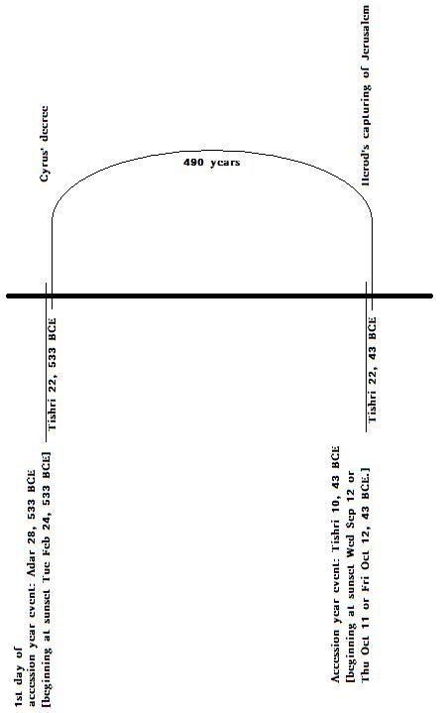
Salvation of Men
Voluntary servitude under kings and States.
U R the State!!! “U SS R”
Thus Daniel’s Stat(u)e
Kings and man made “authorities” are voted in place to become “Saviors” and “insure peace and safety” because “ye were afraid…” (cf. Deut. 5:2-5!)

Slide 107
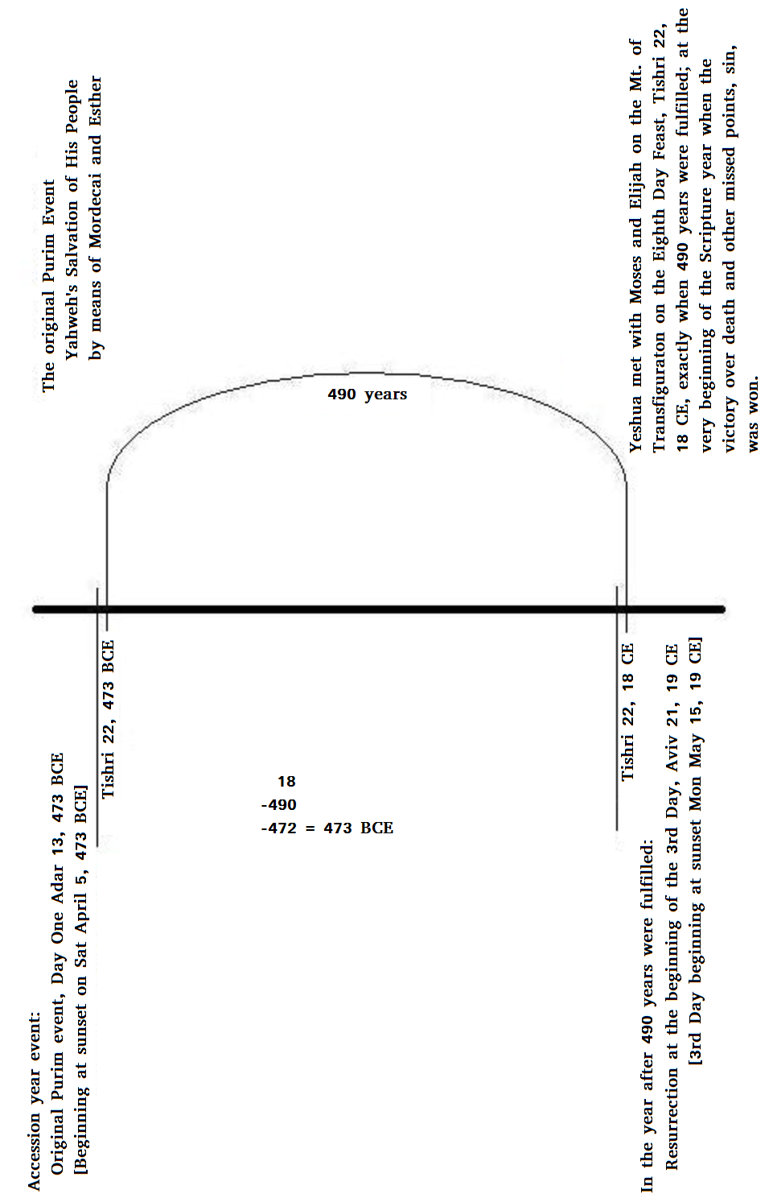
One Escape Option: Yahweh the One Real Savior
The Three Angel’s Messages:
The 1st eternal NOW message: Each of us is free to choose until we refuse…
The 2nd message by choosing to consent to bondage – by voting, by registering, by applying for various licenses, &c..
The 3rd message: The Creator’s natural consequences do follow!!!
Yahweh is there to lead each One out of bondage!
That is: Each One who wishes to listen and accept His offers – and follow!

Slide 108
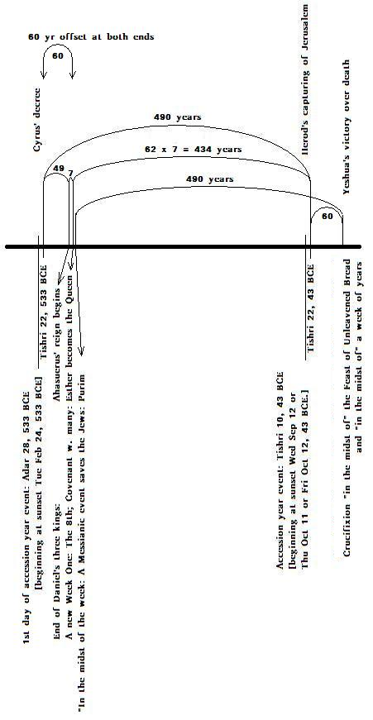
Escaping the Circle of Evil to that which “is (?) too good to be true”
Consider this “too good to be true” prophetic design!
R U getting the message yet?
Or are you too too “afraid” to trust your Father, your Creator, your Source?
R U noticing that it’s a matter of being tuned into another paradigm of time? – God’s!

Slide 109
Daniel 9:24
“…שׁבעים שׁבעים”
What does it mean?
Learn more at:
http://adamoh.org/TreeOfLife.lan.io/home.htm

Slide 110
What steps R U taking?
A little of my story will follow…:
I was told to be His witness, by sharing my own first hand experiences…
Matthew 28:18-20

Slide 111
I Inherited the 7th Day Sabbath Truth!
My great grand parents studied the Scriptures for themselves and discovered the 7th Day Sabbath truth…
Years later they were told that some equally strange people had arrived from America… Ellen White had just arrived to Scandinavia!
Praise the Lord!

Slide 112
More Heritage Blessings
My mother’s family were tailors and missionaries at home. Their children all became missionaries to far away countries as well!
They learned that all things are possible with God, our Creator.
Praise the Lord of Hosts!

Slide 113
More Heritage Blessings
None of my four grand parents, nor my parents, used any alcoholic beverages.

Slide 114
More Heritage Blessings
None of my four grand parents, nor my parents, used tobacco.

Slide 115
More Heritage Blessings
None of my four grand parents, nor my parents, used any tea [containing theophylline.]

Slide 116
More Heritage Blessings
Three of my grand parents and my parents never used coffee.

Slide 117
More Heritage Blessings
I was privileged to grow up, from age four, on the country side, in an SDA community…

Slide 118
Unlimited Inheritance…
My Father’s mother accepted the Seventh-day Adventist message as a youth and thus all her children were greatly blessed as was their father – her life time husband!
My Father committed his life to the SDA health message and shared his blessings with very many…
I missed him much, but was blessed too!
Praise the Lord of Life!

Slide 119
I Learned by Remembering…
I missed my father who was, I thought, too much at work.
By age 5 or 6 I learned and decided to give priority to my family.
I did. I am. Its not always easy…
Good thing I can trust my Savior!
No reason ever to give up on my own family responsibilities!!!
Praise the One and Only!!!

Slide 120
My Mother Taught me
The Health Message is for real:
She cut sugar as a preservative from 50% to 25% in my early teens.
No losses. Only gains!
Praise the Lord!

Slide 121
Real Life consequences
I gained weight. Too much. Went into denial.
Eventually I realized the truth: I was eating too much chocolate.
I decided to quit chocolate. I was 32 or so. 28 years ago. Never tasted it since.
The problem disappeared never to return.
Praise the Lord, my Savior!

Slide 122
I learned from my mother’s death
My mother died after three years of fighting her cancer.
I did all I could, day and night, to learn all about cancer…
I was always only one step behind – or so I thought…
I learned that it is too late to wait until I too get ill.
The time to change is now, Right NOW!!
The more the better!

Slide 123
My Wife is a Blessing
I learned, and I am learning, more by means of her than from anything else I know of outside of the Scriptures, which alone open my eyes where I am blind…
Praise the Lord who created my family into His / Their own image!

Slide 124
My Little Ones Taught Me Much
There is so, so much for a father to learn from his very own babies… every day throughout their lives!
Blessed be the Family of Heaven!

Slide 125
I didn’t believe cholesterol was bad
What I learned in Medical School made me doubt that cholesterol causes illness…
I kept fighting the idea, by studying to prove it wrong…
In the end I was convinced I had been wrong.
Consequence: I cut out all cholesterol foods. Simple enough: Eat no animal products!
A decision was all it took. And sticking to it! When I learned that it no longer tasted good once I had quit the habit for a while. Not even my very favorites tasted as they used to!
I never missed it since!

Slide 126
Why Substitutes?
I used to always have plenty of milk on my morning cereal and plenty of butter and cheese on my bread.
After my decision to quit animal foods I was facing my first breakfast. What should I eat???
I decided I didn’t need any substitutes either.
Surprise, surprise! It tasted great without!
The more I chewed my cereal the better it tasted, even with no liquid added...
Praise the Lord!

Slide 127
I learned from my colleague
My colleague and best friend came home one day sharing the good news that his 2 weeks of lymphadenopathy, inflamed glands, had disappeared in a matter of minutes upon taking Q10 capsules, 10 mg!
Great stuff! I shared it with many over the years! Instant cures of much disease. But most of my colleagues distrust it because “it is too good to be true…”
To each their own… Too bad for their patients!!

Slide 128
I learned by sharing
I shared the health message as best I could with all my patients…
Repetition is a great teaching tool!
Thinking about things over and over again makes one realize things one would never otherwise consider!
Praise the Lord, my Teacher above all!

Slide 129
Vegans have no colds
Except when eating something I didn’t know had traces of dairy, I never had a sore throat again, no stuffy nose… ! I learned that this experience is common among vegans.
Children raised on a complete vegan diet rarely if ever have ear aches, ear infections or other infections… Provided of course that they eat a well rounded diet from all four vegan food groups: 1) nuts and seeds, 2) whole grains, 3) fruit, and 4) vegetables.
Praise the Lord, the Greatest Physician of all!

Slide 130
I wanted to test fasting…
I ended up learning that I didn’t need legumes of any kind and that throughout my life I had had much more gas than I needed to.
As says Ellen White: “For me they are poison…”
But that’s me! Yet, I believe all too many SDA’s are dying prematurely because of way too much soy protein, too much refined soy! Too few natural phyto chemicals! Simply put: Lack of essential nutrients!

Slide 131
Then I learned it the hard way…
Like others, I too was claiming to be one with the Stat(u)e. I too was married under a State Marriage License. I too was carrying a Drivers License, a Medical License, and on and on…
Then, though certainly not ever before having considered myself property of the Stat(u)e and one with her – “the Stat(u)e of Liberty,” suddenly she kidnapped my family from me. And me from them. We all suffer, me, my wife, our little ones – still! Exceedingly!!!
The Third Angel’s Message in verity. And in consequence of not heeding the Second Angel’s Message in time! Or even the First…

Slide 132
Then I learned it the hard way…
She, “the Stat(u)e of Liberty,” considered our children hers and not mine, and me as an intruder, and not her husband. So I was rejected. Even imprisoned. What mental and emotional torture!
Then I learnt that it was my fault for thinking it expedient to IDentify myself as a “person,” as a representative of, and for, the Stat(u)e.
Identifying myself as a subject under the head of the Stat(u)e was and is the same as delegating all my responsibility to another – barring none!
Making myself a slave owned by another.

Slide 133
Then I learned it the hard way…
She used my ID claims as proof that the responsibility was on her… and accordingly, that I was in effect no more the head of my own family.
By my very own choice! It was all my fault!
And it was… and is… to the extent that I am still one with her. To the extent that I am still not effectively heeding the call: “Come out of her, ye my People!”

Slide 134
Then I learned it the hard way…
So I did my very best to rescind all my license applications, all my licentiousness!
Got rid of my Marriage Certificate, my Drivers Licenses, my Medical Licenses, my Pilot license, eventually even my Passports and my Citizenships.
And God is blessing me as I am doing my best to heed His call for me to get out of Babylon. To cease being one with her. One with the Stat(u)e.

Slide 135
Then I learned it the hard way…
I got a free, but involuntary, trip to America – for still not being able to effectively abstain from giving cause to the Stat(u)e for thinking the responsibility was on her.
I had a hard time getting back, but with time I learned.
First how to fly domestically without an ID. That one was easy! “I am traveling without ID today Sir!”
Then I had the blessing of traveling in a yacht across the ocean. Her name is Milagro. Spanish for Miracle! Indeed it was! And what a joy to get to know the ocean!
No serious problems passing and facing a number of customs officers. They seem more knowledgeable - and therefore more helpful - than the fearful serfs representing the international airplane industry.

Slide 136
Well, I keep on learning…
As Yeshua said: “I am the way, the truth, and the life” John 14:6.
Isn’t that the name of the game?

Slide 137
No doubt you do too…

Slide 138
Praise the Lord of Hosts!
Learn more at:
http://adamoh.org

