Slide 1
In what years Exactly did Jesus begin and end his mission?

Slide 2
Do you wish to be a part of knowing and teaching the truth?
- Or is it ok with you to keep or to teach a known lie?

Slide 3
In what Julian year did Caesar Tiberius’ 15th year of reign fall?
That is, the 15th year as referenced in Luke 3:1-2 (KJV:)
1 Now in the fifteenth year of the reign of Tiberius Caesar, Pontius Pilate being governor of Judaea, and Herod being tetrarch of Galilee, and his brother Philip tetrarch of Ituraea and of the region of Trachonitis, and Lysanias the tetrarch of Abilene,
2 Annas and Caiaphas being the high priests, the word of God came unto John the son of Zacharias in the wilderness.

Slide 4
Can you prove, for instance, that the crucifixion fell in 31 AD, or in 33 ad, or in neither one?
Can you prove that Jesus was baptized in 27 AD, or in 29 AD, or in neither one?

Slide 5
Within a few minutes – once you’ve seen and understood this brief presentation – you’ll have clear and certain answers to questions such as these …
Perhaps, in addition, you’ll need a bit of time for reflection of your own, that is, re such questions as you may need to ask yourself before being ready and prepared to fully accept the blessings and the insights that follow in consequence of these answers…

Slide 6
Ceasar Augustus died in 10 CE - Not in 14 CE as commonly assumed… - The event heretofore considered the chief foundation for our reckoning of time is flawed and in need of correction…
Four simple, easy, and certain steps
towards one final point of proof…

Slide 7
Phlegon’s solar eclipse: When?
Phlegon’s solar eclipse:
Did it fall in 29 CE or in 33 CE?

Slide 8
Phlegon’s record re the solar eclipse as translated into English
Origen (“ca 185 - ca 254 A.D.:”)
English translation (emphasis added:)
"And Phlegon also who compiled the Olympiads writes about the same things in his 13th book in the following words: 'In the fourth year of the 202nd Olympiad, an eclipse of the Sun took place greater than any previously known, and night came on at the sixth hour of the day, so that stars actually appeared in the sky; and a great earthquake took place in Bithynia and overthrew the greater part of Niceaea;"
(“From: Phlegon, Olympiades, fragment 17. Quoted in Historical Eclipses and Earth's Rotation, by F Richard Stephenson, Cambridge University Press, 1997, page 359-360;” Solar Eclipse Newsletter, Vol. 8:11, Nov 2003, p. 5:4. Cf. Google Book Search and MrEclipse.com.)

Slide 9
The path of the total solar eclipse of November 24, 29 CE

Slide 10
NASA’s note Re the solar eclipse as observed from the Damascus horizon:

Slide 11
The solar eclipse of 29 CE at 11:21 local solar time as it appears on Starry Night Backyard from the Damascus horizon…

Slide 12
The solar eclipse of 29 CE at 11:23 local solar time

Slide 13
The solar eclipse of 29 CE at 11:25 local solar time

Slide 14
The solar eclipse of 29 CE at 11:27 local solar time

Slide 15
The solar eclipse of 29 CE at 11:29 local solar time

Slide 16
The solar eclipse of 29 CE at 11:31 local solar time

Slide 17
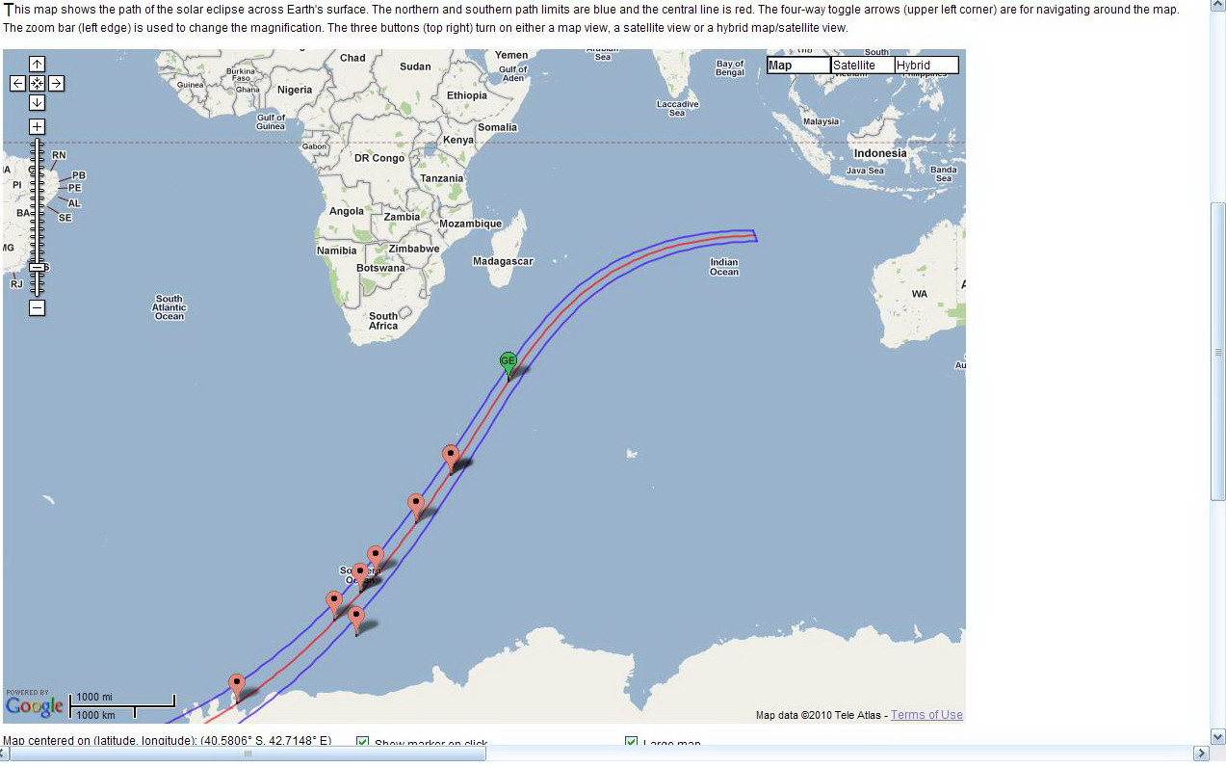
The path of the total solar eclipse of March 19, 33 CE

Slide 18
The 33 CE Total solar eclipse at the coast of Antarctica ! concluded at 09:46 – that is, in the 4th hour

Slide 19
The 33 CE Total solar eclipse local solar time between 10:51-10:54 AM – that is, in the 5th hour

Slide 20
The 33 CE Total solar eclipse local solar time between 11:27-11:31 AM – that is, in the 6th hour

Slide 21
The 33 CE Total solar eclipse local solar time between 12:07-12:10 AM – that is, in the 7th hour

Slide 22
The 33 CE Total solar eclipse local solar time between 12:43-12:47 AM – that is, in the 7th hour [at the damascus longitude]

Slide 23
If Phlegon’s eclipse fell in 33 CE… Where on this map must the observer have been?
6th hour
7th hour
5th hour
4th hour

Slide 24
March 19, 33 CE… What season of the year was that at this location?
6th hour
7th hour
5th hour
4th hour

Slide 25
At the time of the fall storms in 33 CE… How likely is Phlegon’s observer to have been at this location?
6:e timmen
7:e timmen
5:e timmen
4:e timmen

Slide 26
At the time of the fall storms in 33 CE… How trustworthy is a calendar anchored primarily upon this eclipse?
6:e timmen
7:e timmen
5:e timmen
4:e timmen

Slide 27
The path of the 29 CE solar eclipse

Slide 28
The 29 CE Total solar eclipse local solar time between 10:31-10:33 AM – that is, in the 5th hour

Slide 29
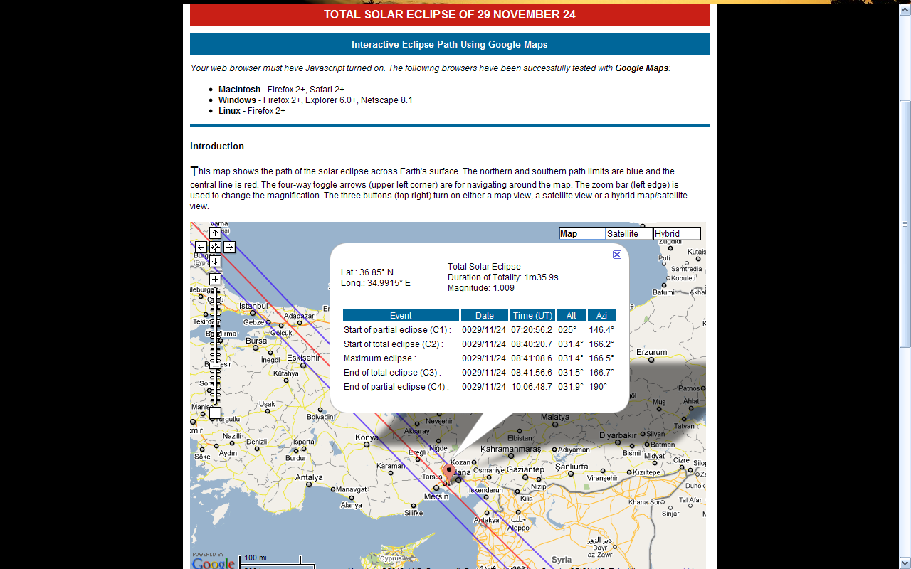
The 29 CE Total solar eclipse local solar time between 11:00-11:02 AM – that is, in the 6th hour

Slide 30
The 29 CE Total solar eclipse local solar time between 11:16-11:18 AM – that is, in the 6th hour

Slide 31
The 29 CE Total solar eclipse local solar time between 12:06-12:08 AM – that is, in the 7th hour

Slide 32
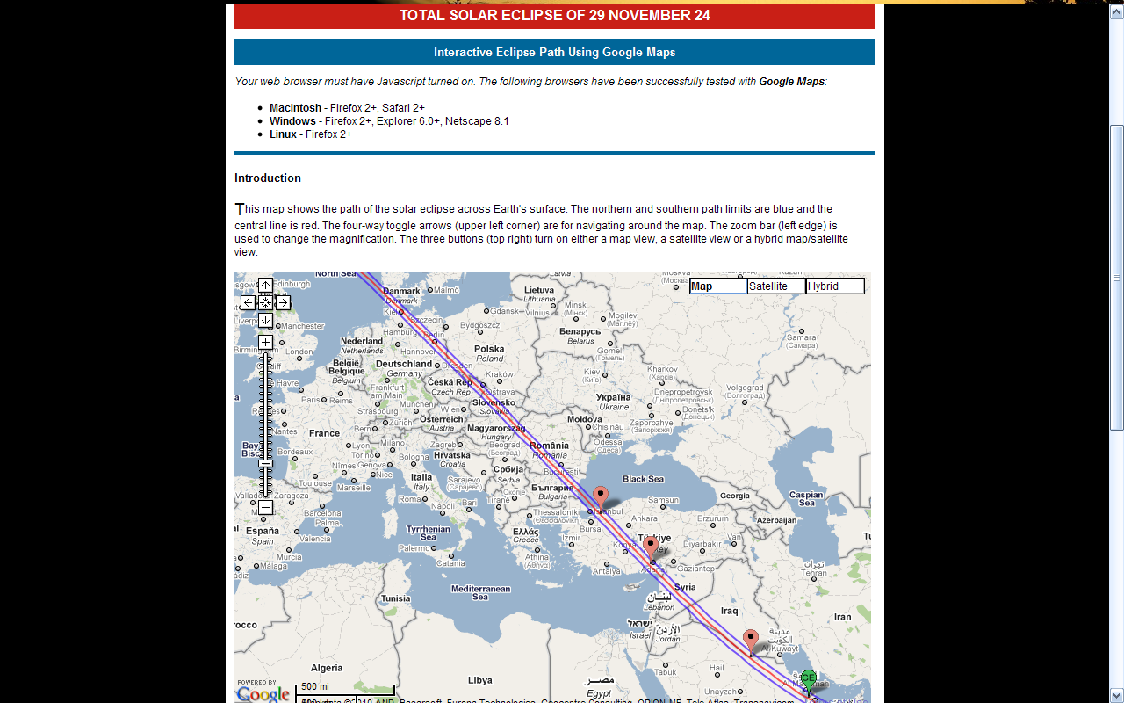
If Phlegon’s eclipse fell in 29 CE… Where on this map must the observer have been?
6th hour
7th hour
5th hour
6th hour

Slide 33
Where was Phlegon’s observer located? In the Middle East or near Antarctica?

Slide 34
What does Astronomy science say? - Those who are specialists on solar eclipses?

Slide 35
”the reference to AD 32-33 being incorrect…”

Slide 36
What other anchors are there for the Olympic calendar?
There are solar eclipses harmonizing with both 33 CE and with 29 CE
For a table of other anchor points in time you may wish to study my web article at this URL: http://adamoh.org/TreeOfLife.lan.io/NTCh/CrossCorrelatingHistory&Astronomy.htm

Slide 37
The historical reference…
"The original discovery [of the cause of eclipses] was made in Greece by Thales of Miletus, who in the fourth year of the 48th Olympiad foretold the eclipse of the Sun that occurred in the reign of Alyattes, in the 170th year after the foundation of Rome"
(Pliny, Naturalis Historia, II, 53.)

Slide 38
What is an Olympic year?
Answer:
The New Year begins annually on July 1 of a Julian calendar…
Conclusion:
The 4th year of the 202nd Olympiad began with July 1, 29 CE.
- Ok, but what does the Olympic calendar mean to me hear and now?

Slide 39
Let’s consider… the Julian/Gregorian calender and the Olympic calender as simply two separate time zones…

Slide 40
What ”time zone” do you relate to? For instance when you wish to consider the dates given by an ancient historian such as Josephus?
Julian calendar |  | Jan-Dec 2010 |  | Jan-Dec 2011 |  | Jan-Dec 2012 |  | Jan-Dec 2013 |  | Jan-Dec 2014 |  | Jan-Dec 2015 |  | Jan-Dec 2016 |  | Jan-Dec 2017 |  | Jan-Dec 2018
Olympic calendar anchored in the solar eclipse of November 24, 29 CE | Jul-Jun year 4 of cycle number |  | Jul-Jun year 1 of cycle number |  | Jul-Jun year 2 of cycle number |  | Jul-Jun year 3 of cycle number |  | Jul-Jun year 4 of cycle number |  | Jul-Jun year 1 of cycle number |  | Jul-Jun year 2 of cycle number |  | Jul-Jun year 3 of cycle number |  | Jul-Jun year 4 of cycle number
 | 697 |  | 698 |  |  |  |  |  |  |  | 699
Olympic calendar anchored in the solar eclipse of March 19, 33 CE | Jul-Jun year 1 of cycle number |  | Jul-Jun year 2 of cycle number |  | Jul-Jun year 3 of cycle number |  | Jul-Jun year 4 of cycle number |  | Jul-Jun year 1 of cycle number |  | Jul-Jun year 2 of cycle number |  | Jul-Jun year 3 of cycle number |  | Jul-Jun year 4 of cycle number |  | Jul-Jun year 1 of cycle number
 | 697 |  |  |  |  |  |  |  | 698 |  |  |  |  |  |  |  | 699

Slide 41
Which anchor is placing the Olympic calendar correctly in time?
Olympic years begin with July 1 [of the Julian calendar] | I Olympiad [Based on 29 CE] |  | Which of these two anchors is placing the Olympic calendar correctly in time? | II Olympiad [Based on 33 CE]
3 | 1 | 195 |  | 194 | 2
2
 | 2 |  |  |  | 3
1 [BCE]
 | 3 |  |  |  | 4
1 [CE]
 | 4 |  |  | 195 | 1
1 July, 5 CE | 4 | 196 |  | 196 | 1
1 July, 9 CE | 4 | 197 |  | 197 | 1
1 July, 13 CE | 4 | 198 |  | 198 | 1
1 July, 17 CE | 4 | 199 |  | 199 | 1
1 July, 21 CE | 4 | 200 |  | 200 | 1
1 July, 25 CE | 4 | 201 |  | 201 | 1
1 July, 26 CE | 1 | 202 |  |  | 2
1 July, 27 CE | 2 |  |  |  | 3
1 July, 28 CE | 3 |  |  |  | 4
1 July, 29 CE | 4 |  | ⬅⬅⬅⬅⬅ Phlegon’s solar eclipse of November 24, 29 CE ⬅⬅⬅⬅⬅ | 202 | 1
1 July, 30 CE | 1 | 203 |  |  | 2
1 July, 31 CE | 2 |  |  |  | 3
1 July, 32 CE | 3 |  | ➔➔➔➔➔ Phlegon’s solar eclipse of March 19, 33 CE ➔➔➔➔➔ |  | 4
1 July, 33 CE | 4 |  |  | 203 | 1

Slide 42
What reality, if any, is behind the dates you find in your own books and in your own Bible?
What’s the result when the authors of history are basing their dates, calendars, and time concepts generally, upon something other than that being used by the original source? Confusion?
Ditto for the translators of the Bible, be such ever so honest and sincere, and doing their very best towards a perfect translation of the Bible? Yet, not having the necessary tools for accomplishing what they might wish…

Slide 43
What difference does it make to you?
If Caesar Augustus died in 10 CE or in 14 CE?
If you are reading a Bible translation using flawed time references?

Slide 44
Question: Which Julian year correspond to the 1st year of the 187th Olympiad?
Step 2 of 4 towards one final point of proof…

Slide 45
Answer: The year that began July 1, 35 BCE corresponds to the 1st year of the 187th Olympiad
A simple calculation using numbers:
(202*4) – (186*4) = 808 – 744 = 64 years.
30 CE – 64 years = -34 = 35 BCE

Slide 46
A simpler and easier way of reckoning towards the same year using a table – Three ways of reckoning years between two dated events
Julian calendar | Olympic calendar |  | Dated events | 1, 2, 3… 64
35 | 187 | 1 | The battle of Actium was concluded Augusti 12 in the 1st year of the 187th Olympiad | 1
31 | 188 | 1 |  | 5
27 | 189 | 1 |  | 9
23 | 190 | 1 |  | 13
19 | 191 | 1 |  | 17
15 | 192 | 1 |  | 21
11 | 193 | 1 |  | 25
7 | 194 | 1 |  | 29
3 | 195 | 1 |  | 33
2 |  | 2 |  | 34
1 |  | 3 |  | 35
1 |  | 4 |  | 36
5 | 196 | 4 |  | 40
9 | 197 | 4 |  | 44
13 | 198 | 4 |  | 48
17 | 199 | 4 |  | 52
21 | 200 | 4 |  | 56
25 | 201 | 4 |  | 60
29 | 202 | 4 | Phlegon’s solar eclipse of November 24, 29 CE | 64

Slide 47
Why do I need to know the beginning of the 187th Olympiad relative to the Julian calendar?
Josephus is giving reference to the 1st year of the 187th Olympiad when dating the conclusion of the battle between Caesar and Mark Atony. That battle began with the battle at Actium on September 2 in the year prior to the year when the battle at Actium was concluded on August 12 when Cleopatra died. According to the words of Josephus: “The battle… fell into the 187th Olympiad…;” and also…
Suetonius provides that Caesar Augustus “ruled the State… by himself for forty-four [years before] he died… on the fourteenth day before the Kalends of September at the ninth hour…” [that is, on August 19 between 2 and 3 PM.]
(Cf. http://adamoh.org/TreeOfLife.lan.io/NTCh/AugustusDateCalculations.htm#AugustusReignBegan )

Slide 48
When began Augustus’ 44 years of ruling the State by himself?
Step 3 of 4 towards one final point of proof…

Slide 49
A simple and easy numerical computation:
1. Augustus began his solo reign on August 12, 35 BCE.
2. Thus, the one year jubilee of that event fell on August 12, 34 BCE… and his 44 year jubilee fell on August 12, 10 BCE.
3. By means of an easy numerical computation: 35 [BCE] + 44 years = -34 + 44 = 10 [CE]

Slide 50
Perhaps an even easier and more direct way of displaying that same result by means of a table - three ways of reckoning years between the two dated events
Julian calendar | Olympic calendar |  | The two dated events | 1, 2, 3… 44
35 BCE | 187 | 1 | The battle of Actium was concluded Augusti 12 in the 1st year of the 187th Olympiad | 0
31 | 188 | 1 |  | 4
27 | 189 | 1 |  | 8
23 | 190 | 1 |  | 12
19 | 191 | 1 |  | 16
15 | 192 | 1 |  | 20
11 | 193 | 1 |  | 24
7 | 194 | 1 |  | 28
3 | 195 | 1 |  | 32
2 | 195 | 2 |  | 33
1 BCE | 195 | 3 |  | 34
1 CE | 195 | 4 |  | 35
5 | 196 | 4 |  | 39
9 | 197 | 4 |  | 43
10 CE | 198 | 1 | The 44th jubilee of the beginning of Caesar Augustus ’ sole regency , August 12, 10 CE. | 44

Slide 51
When did Caesar Augustus die?
Step 4 of 4 towards one final point of proof…

Slide 52
When did Caesar Augustus die?
Thus, Caesar Augustus died on August 19, one week following his 44th jubilee of being the sole regent.
He did not die in “14 A.D.” as commonly taught and believed!
(If you wish to know more re the “14 AD” error, then please follow the links provided under the following link to the more complete quotes of Origen and Phlegon!: http://adamoh.org/TreeOfLife.lan.io/NTCh/AugustusDeath10CEsimplified.htm#OrigenRefTheTotalSolarEclipseIn29BCE)

Slide 53
Question: In what Julian year – at the very latest - did Caesar Tiberius’ 15th year of reign fall??
That is, the 15th year as referenced in Luke 3:1-2 (KJV:)
1 Now in the fifteenth year of the reign of Tiberius Caesar, Pontius Pilate being governor of Judaea, and Herod being tetrarch of Galilee, and his brother Philip tetrarch of Ituraea and of the region of Trachonitis, and Lysanias the tetrarch of Abilene,
2 Annas and Caiaphas being the high priests, the word of God came unto John the son of Zacharias in the wilderness.

Slide 54
Answer: Caesar Tiberius’ 15th year of reign fell in a Julian year no later than 25 CE – Absolutely no later!
[10 [CE] + 15 years = 25 [CE]: Thus, Caesar Tiberius’ 15th year of reign fell in a Julian year no later than 25 CE – That is, at the very latest! And… provided that there was no co-regency between Tiberius and Augustus… which, most definitely, there was…!

Slide 55
Notice the following quote re a co-regency between Caesar Augustus and Caesar Tiberius:
Quoting Caesar Augustus himself:
“A third time, with the consular imperium, p359and with my son Tiberius Caesar as my colleague, I performed the lustrum in the consulship of Sextus Pompeius and Sextus Apuleius.³⁷”
(The Res Gestae of Augustus, Monumentum Ancyranum, Part II)
Cf. http://adamoh.org/TreeOfLife.lan.io/NTCh/TheRegnalYearsAndDatesOfRomanEmperors.htm#TiberiusCaesarsReign

Slide 56
What’s your answer now:
Can you prove that the crucifixion fell in 31 AD, or in 33 AD, or in neither one? When, at the very latest?!
Can you prove that Jesus was baptized in 27 AD, or in 29 AD, or in neither one? When, at the very latest?!

Slide 57
What’s the origin of the idea that Augustus died in 14 CE?
Let’s dig just a little deeper yet…
Let’s briefly review an even more fundamental source of error than this thing re the date of Caesar Augustus’ death…

Slide 58
Is Ptolemy’s Canon of the kings reliable?
Let’s look a little closer at the details in Ptolemy’s Canon of the Kings!
The copied page is from Seventh-day Adventist Bible Commentary, Volume 2, p. 154.

Slide 59
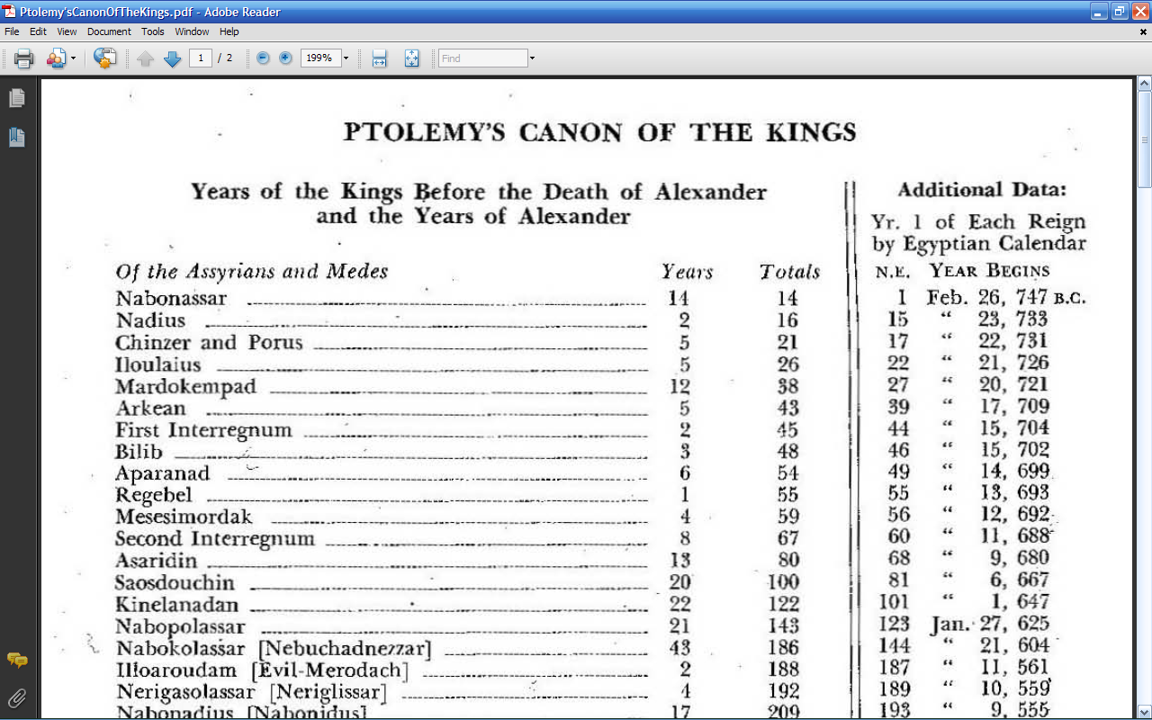
Which day and which year is Ptolemy referencing for the beginning of Caesar Tiberius’ reign?
Is it not the very day following August 19, 14 CE, that is, the very day following the day when Caesar Augustus is commonly assumed to have died?
But, didn’t we just read Augustus’ own words to prove the error of this assumption? Selah!
As it is, this Canon of the Kings constitutes…
the very foundation for the assumption that Augustus died in 14 CE!, and
the very foundation for most of ancient history writing and chronology…

Slide 60
Augustus’ death i only one of many and fundamental errors in detail within Ptolemy’s Canon of the Kings… upon which most of conventional history writing and conventional chronology is being built…
Upon what exactly are you building your own concepts of time and your own teaching?
Are you building upon Static heresies that are never being corrected, heresies being steadily built upon while yet being eroded at the opposite end? A sand castle on the beach?
Or, are you building upon that rock of ages being referenced by Yeshua/Jesus as quoted in Matthew Matteus 7:24-25, referenced in Daniel 7:9, 13, 22, 25, and which finds its basis in Genesis 1:14-19? Are you building upon a purely Scriptural calendar based solidly upon its mirror image as found the movements of the sun, the moon, and the stars as visible on the sky? How familiar are you with that Scriptural calendar?
For many years now, I’ve been studying the Scriptural caendar. I’ve had much to unlearn and to learn. Often new insights on an almost daily basis… and it goes on and on… God, the God of Truth, the Creator of the Universe, is my private tutor. Praised be His name, Jahweh Elohim, and all that that name is pointing to!
Please, if you wish, you are ever welcome to partake of that which our Creator is showing me, and which He allows me to publish on these web pages of mine:
Specifically re the within subject matter: http://adamoh.org/TreeOfLife.wan.io/OTCh/PtolemysCanonAndAlmagestQuestioned.htm
Generally re Scriptural time concepts:
http://adamoh.org

Slide 61
What’s your answer now?:
Among the following: Who will prove most willing to stand upright for the truth and for that which is inherent in these words?:
Sola Scriptura – The Bible, and nothing but the Bible!”
Seventh-day Adventists, each and all?,
Jehova’s Witnesses, each and all?,
Messianic Jews, each and all?,
Karaitic Jews, each and all?, or
Pentecostals, each and all?
Do each of these denominations consist of people that are continually climbing towards higher vistas, towards ever more correct insights into the Word of God, or… Could it be that one as the other of these groups of people generally prefer sitting, as says King David: ”in the seat of the scornful…” Psalms 1:1
In whom do the Sons and Daughters of Jahweh Elohim seek their resort, their security, and their references of truth?: 1) Within their own group, church, and congregation, or 2) in none other than the God of Truth Himself and in the real time reality being created by Him? Psalm 118:8

